Slide 1
Testing online shop www.dyfashion.ro
By Carmen Andreea Zăgrean

Slide 2
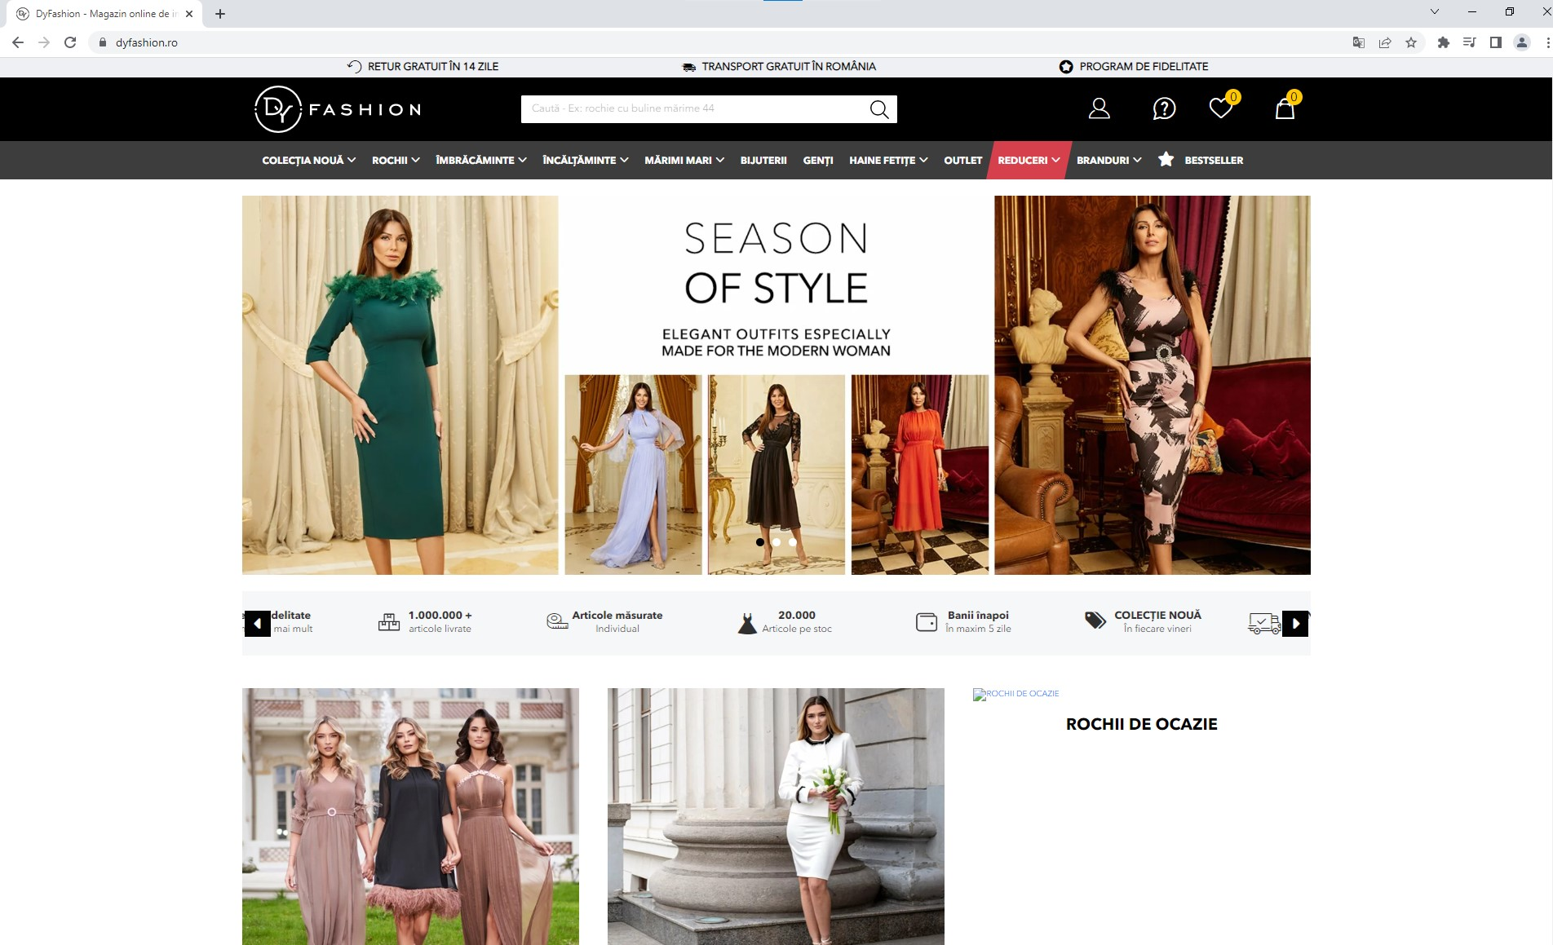
www.dyfashion.ro

Slide 3

About Dy Fashion:
Women’s online store for clothes, shoes, jewelry and bags;
On the market since 2012;
Over 20000 items with sizes from S to 6XL;
30 employees;
New weekly collections;
Community with over 200000 customers;
Trusted online store according – www.trusted.ro;
According to site’s information, the connection is secure (https) and the certificate is valid until 16th September 2023;
Customers can create an account, subscribe to newsletter, add item to favourite section, add item to cart, finish an order by paying online with PayU platform, or cash at delivery, choose the delivery company or the easyBox, return the product, they have a fidelity program etc;
The target customers are Romanian women, the language is Romanian.

Slide 4
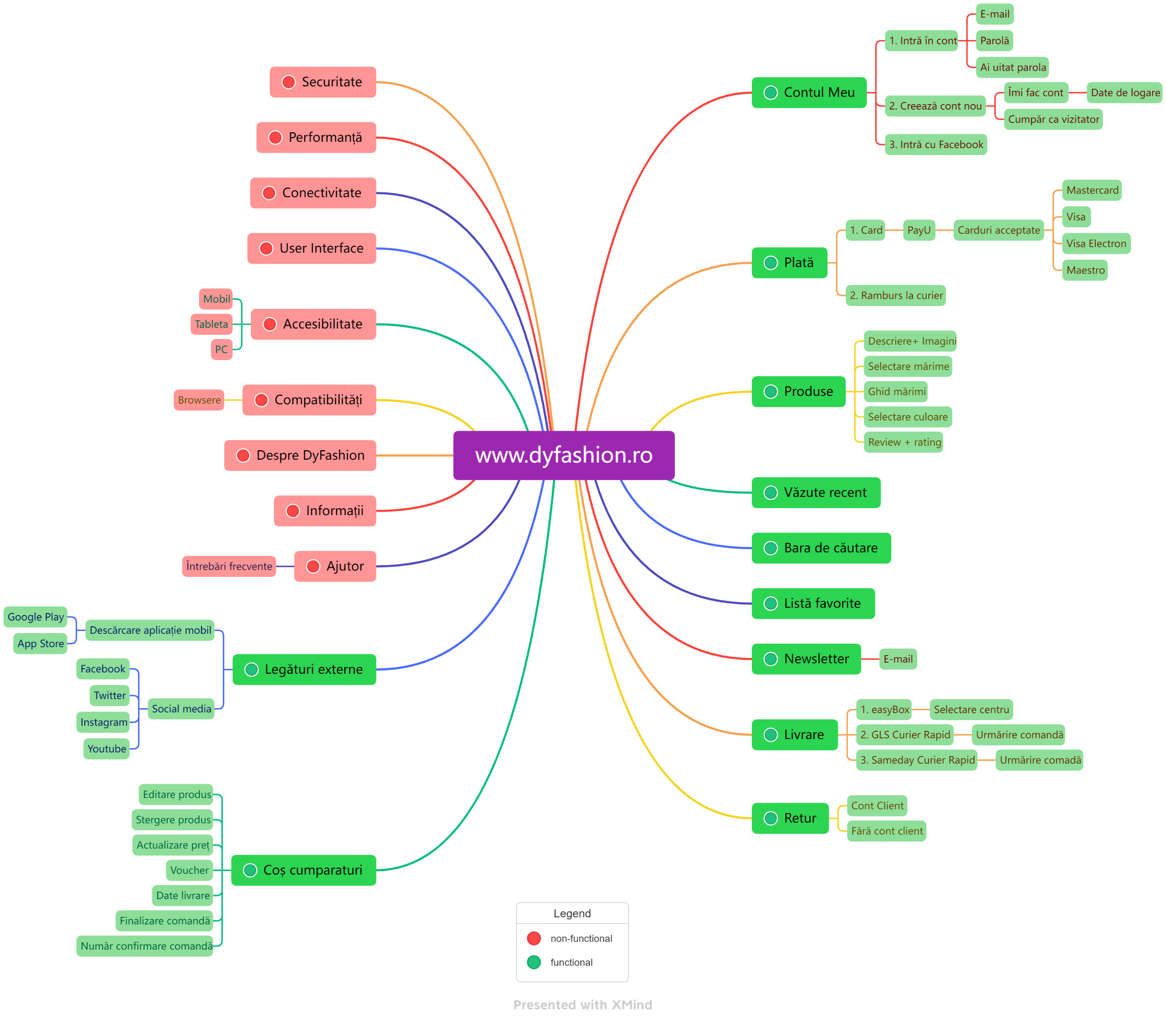
Mind Map

Slide 5





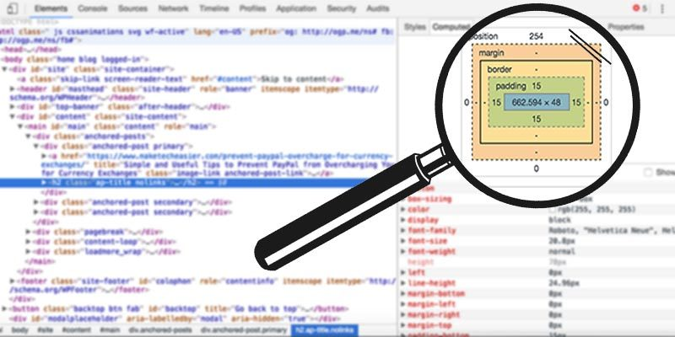
Tools used:
TestLink
Mantis Bug Tracker
X MindMap
Semrush
Excel
Inspect from Google

Slide 6

Testing types performed:
Exploratory Testing;
Smoke Testing;
Ad-hoc Testing;
Compatibility Testing;
Accessibility Testing;
UI Testing;
Positive Testing;
Negative Testing;
Performance Testing;
Security Testing;
Usability Testing;
End-to-End Testing.

Slide 7
Executed test cases & Results:
Functionality | Total | Pass | Failed | Blocked | Not Run
1.My account | 36 | 29 | 2 | 5 | 0
2.Products | 21 | 13 | 8 | 0 | 0
3.Search bar | 5 | 4 | 1 | 0 | 0
4.Seen recently | 3 | 2 | 1 | 0 | 0
5.Favorites | 8 | 4 | 4 | 0 | 0
6.Newsletter | 10 | 5 | 5 | 0 | 0
7.Cart | 26 | 17 | 9 | 0 | 0
8.Delivery | 3 | 3 | 0 | 0 | 0
9.Payment | 3 | 3 | 0 | 0 | 0
10.Links | 16 | 15 | 1 | 0 | 0
11.Connectivity | 5 | 5 | 0 | 0 | 0
12.Compatibility | 4 | 2 | 2 | 0 | 0
13. Accesibility | 2 | 2 | 0 | 0 | 0
14.Performance | 4 | 4 | 0 | 0 | 0
15.Security | 2 | 2 | 0 | 0 | 0
16.User interface | 1 | 0 | 1 | 0 | 0
17.Total | 149 | 110 | 34 | 5 | 0

Slide 9
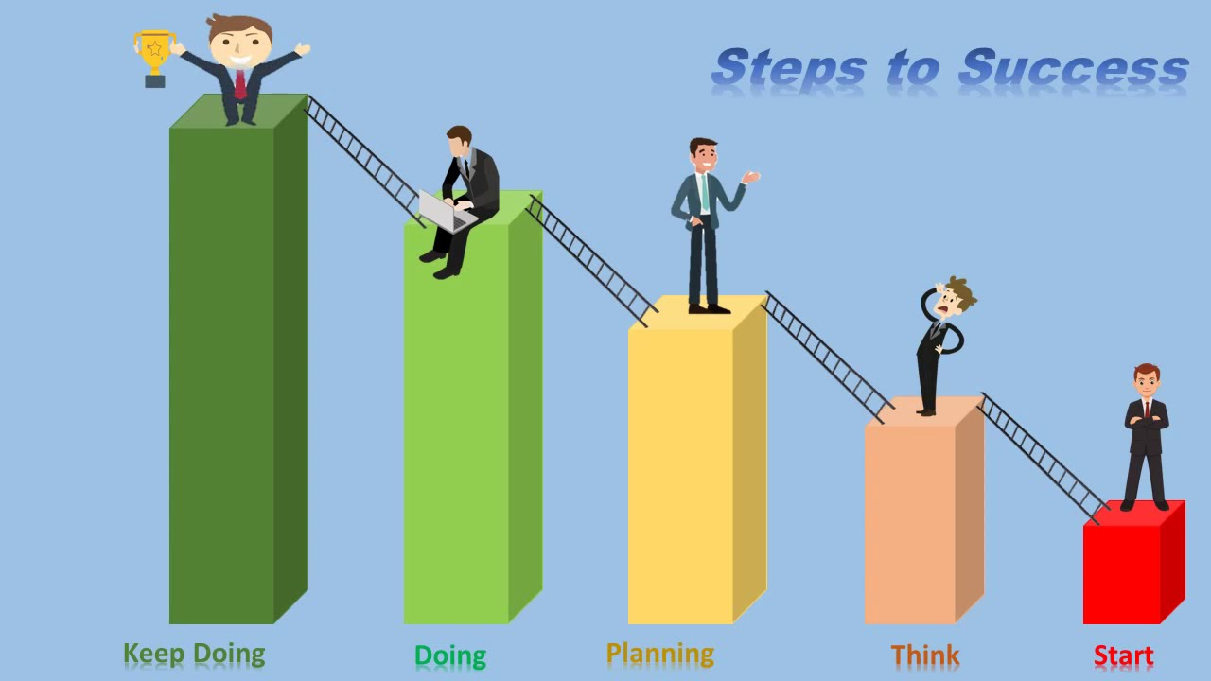
Executed Test Steps & Results:
Test overview | Status
 | Pass % | No of tests | Passed | Failed | Blocked | Not tested
Contul Meu | 95.76% | 165 | 158 | 2 | 5 | 0
Produse | 88.71% | 62 | 55 | 6 | 1 | 0
Bara de cautare | 92.86% | 14 | 13 | 1 | 0 | 0
Vazute recent | 88.89% | 9 | 8 | 1 | 0 | 0
Lista favorite | 77.78% | 18 | 18 | 4 | 0 | 0
Newsletter | 71.43% | 21 | 15 | 1 | 5 | 0
Cos Cumpărături | 89.89% | 89 | 80 | 9 | 0 | 0
Livrare | 100.00% | 10 | 10 | 0 | 0 | 0
Plata | 100.00% | 7 | 7 | 0 | 0 | 0
Legături externe | 97.62% | 42 | 41 | 1 | 0 | 0
Conectivitate | 100.00% | 22 | 22 | 0 | 0 | 0
Compatibilitati | 100.00% | 14 | 12 | 2 | 0 | 0
Accesibilitate | 100.00% | 4 | 4 | 0 | 0 | 0
Performanta | 100.00% | 12 | 12 | 0 | 0 | 0
Securitate | 100.00% | 7 | 7 | 0 | 0 | 0
User interface | 50.00% | 2 | 1 | 1 | 0 | 0
Total | 92.97% | 498 | 463 | 28 | 11 | 0

Slide 10

New bugs:
Defect ID | Defect summary | Severity
0049966 | Footer Menu: duplicate information | Minor
0049968 | Add comment: empty fields are not updated to the warning message | Normal
0049969 | Spelling error | Minor
0049970 | My account: Name Field – no character limit | Major
0049972 | My account: “Prenume” Field – no character limit | Major
0049973 | My account: “Email” Field – accepts a letter for username | Major
0049974 | My account: “Email” Field – accepts a number for username | Major
0049976 | My account: “Email” Field – accepts a number for domain | Major
0049977 | My account: “Email” Field – accepts no limit numeric input for username | Major
0049978 | My account: “Email” Field – accepts a letter for domain | Major
0049979 | Back in stock: no confirmation message for valid input | Normal
0049980 | Back in stock: “Email” Field – accepts only numeric input for username | Major
0049981 | Back in stock: phone field - accepts special characters | Major
0049982 | Back in stock: phone field - accepts letters | Major
0049983 | Back in stock: phone field - accepts only a number | Major
0049984 | Back in stock: phone field - no limit for numbers | Major
0049985 | Leave a comment section – Internal Server Error (500) for valid input | Major
0049986 | Leave a comment section – double review – Internal Server Error | Normal
0049987 | Search bar – word written in english – no error message | Normal
0049988 | Seen recently – update with delay for more than 7 products | Normal
0049989 | Favorites – move an item from fav to cart | Normal

Slide 11
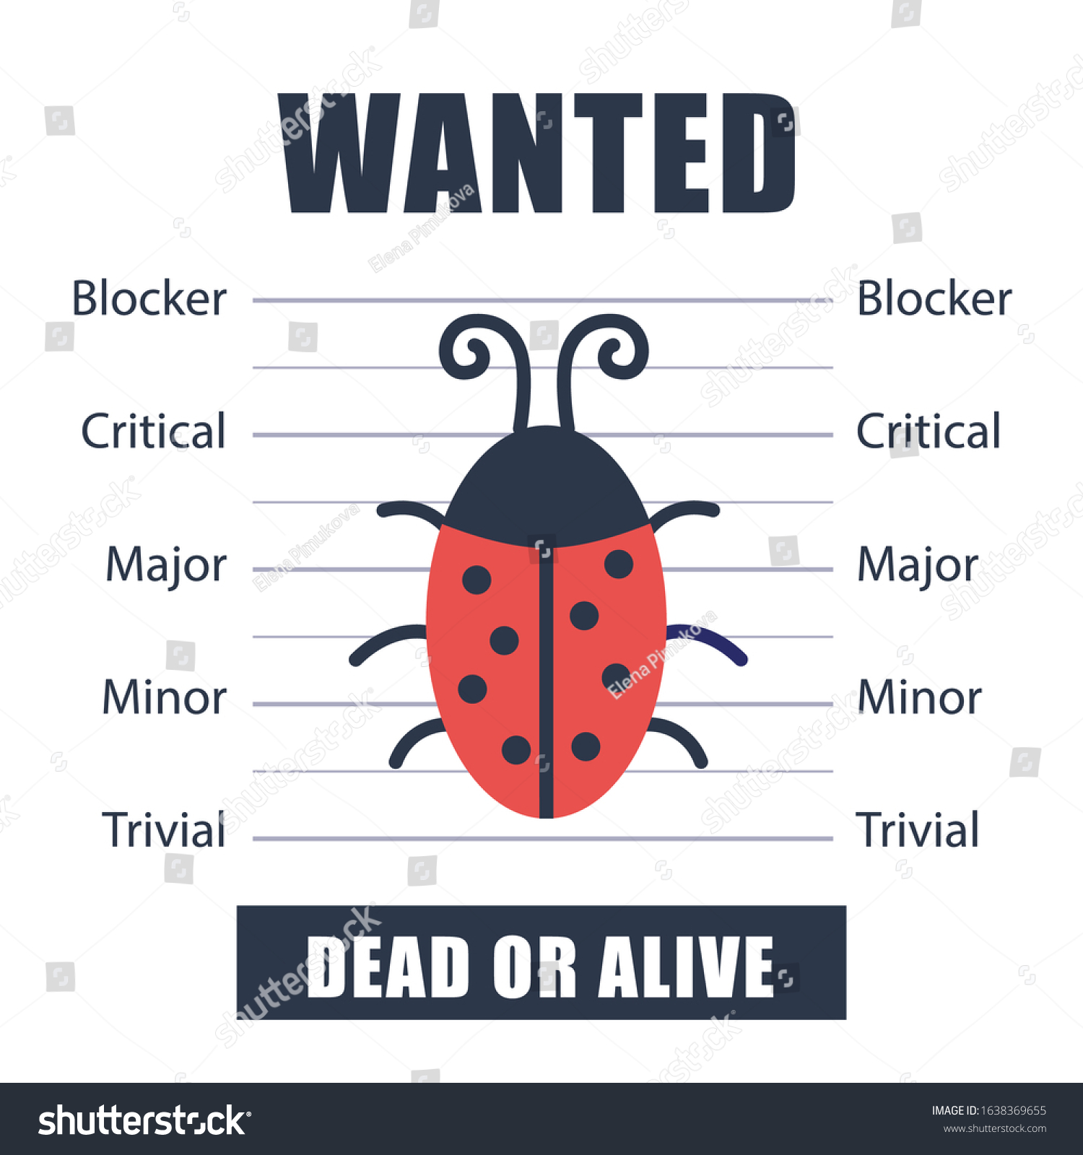
New bugs:
Defect ID | Defect summary | Severity
0049990 | Favorites – no limit for adding products | Normal
0049991 | Favorites – wrong display for more than 99 products in fav icon | Normal
0049992 | Favorites – no limit for leaving the products in this section | Normal
0049993 | Newsletter: Email field accepts only numeric input for username | Major
0049994 | Newsletter: Email field accepts only a letter input for username | Major
0049995 | Newsletter: Email field accepts only a number input for username | Major
0049996 | Newsletter: Email field accepts only a letter input for domain | Major
0049997 | Newsletter: Email field accepts only a number input for domain | Major
0049998 | Newsletter: Email field accepts no limit letters input for username | Major
0049999 | Update cart: after deleting the products the cart is not updated | Normal
0050000 | Cart: no limit for adding products | Major
0050001 | Cart – wrong display for more than 99 products in cart’s icon | Major
0050002 | Finish the order as a guest – numeric input for first and last name | Major
0050003 | Finish the order as a guest – no formatting for phone field | Major
0050004 | Finish the order as a guest – no formatting for address field | Major
0050005 | Finish the order as a guest – address field accepts special characters | Major
0050006 | Finish the order as a guest - address field accepts data without a number | Major
0050007 | Finish the order as a guest - address field without character limit | Major

Slide 12
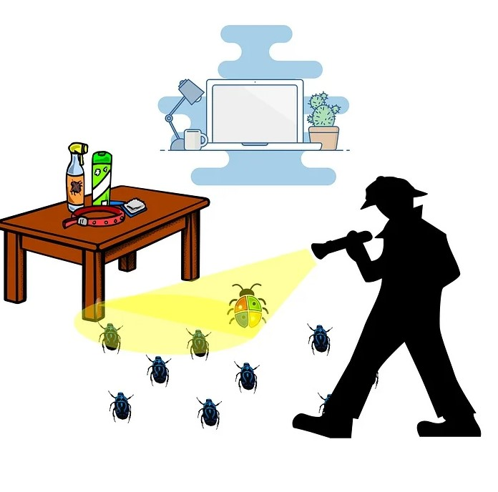
New bugs:
Defect ID | Defect summary | Severity
0050008 | Finish the order as a guest – invalid, but accepted data for all fields | Major
0050009 | External links – GPeC image with no connection to the webpage | Minor
0050010 | Add to cart using the same account, but 2 different browsers (Chrome – Mozilla) | Major
0050011 | Add to cart using the same account, but 2 different browsers (Chrome – Edge) | Major
0050012 | Internal link pages – text with hyperlink, next to text without hyperlinks | Minor
0050013 | Different display with error for empty search bar | Minor

Slide 13
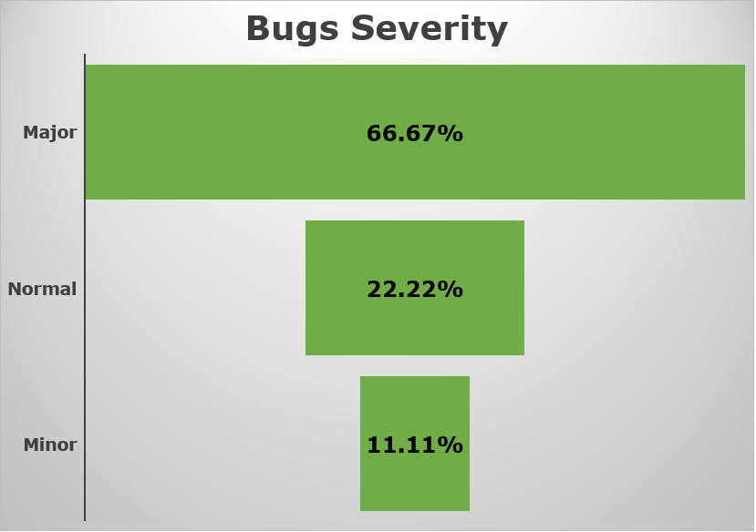

Slide 14

Conclusions:
149 test cases were run with the following status: 110 passed, 34 failed, 5 blocked;
92,97% of the steps executed have the status passed;
45 bugs were opened with the following Severity: 5 minor, 10 normal, 30 major;
Most of the fields are not formatted according to valid inputs. The server is getting too busy and the other pages will take longer time to load. Internal Server Error – status 500 it is a common message for this site;
The fields required to fill in to create an account are too permissive and the server’s memory is full of invalid information;
The fake orders also cause memory loading problems;

Slide 15


Lessons learned:
It is difficult to test a web page without having the requirements;
The more test cases we run increases chances to detect bugs;
Mind Mapping is the first step in a project because it helps to organize and find the main features to be tested;
To run the test cases it is necessary to manage the time because some tests can take a long time (example: leave a product for 1 week in the cart);

